Slide 1
Financial and Accounting Analytics of Stock Returns During Market Shock of Early 2022
Eunjin(Jenny) Jeong

Slide 2

Problem Statement
For the first quarter of 2022, all major stock benchmarks dropped significantly
Multiple economic issues affected “Stock market shock”- supply chain, inflation, fed rate, and Russia's invasion.
Analysis of what financial and accounting factors affected the stock returns early 2022

Slide 3
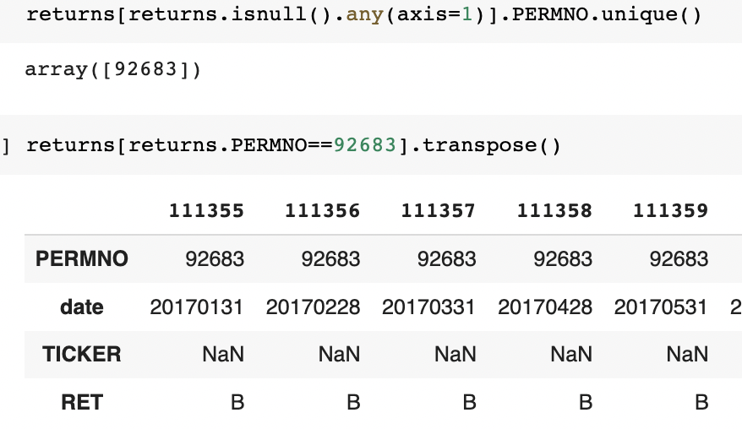
Risk Exposure Analysis - Data
Monthly Stock Return Data
Sample Size
January 2017 to December 2022 of 1886 companies
114715 observations and 4 columns
1924 unique values in Ticker: change history ex) Merger
Missing Values - Drop
15 obs in RET: target variable
62 obs in Ticker: all from same company(PERMNO=92683, EVO)
Less than 0.1% of total number of observations
String in RET - Drop
13 obs, RET == ‘C’ or ‘B’
Fama-French factor returns
60 observations - 60 months
Datadate, mktrf, smb, hml, rf
No missing value, Merge with monthly stock return data
EVO
Notes:
STEP (1) OF ANALYSIS (RISK EXPOSURES): Discuss data (sample size, how did you deal with missing observations? How did you deal with outliers?)

Slide 4
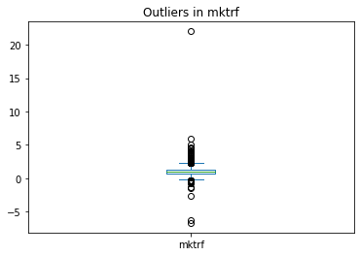
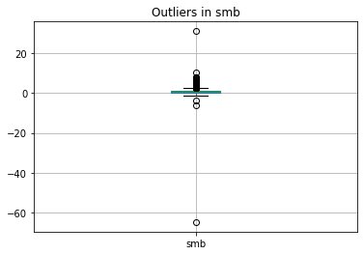
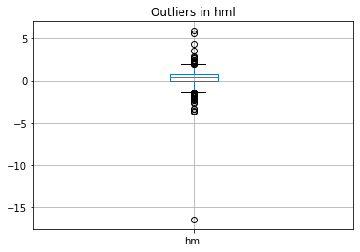
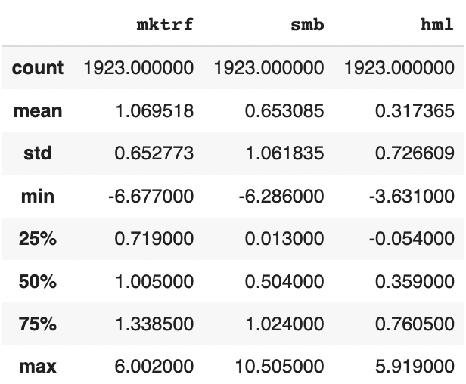
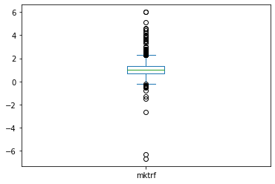
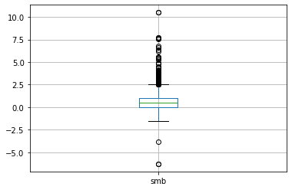
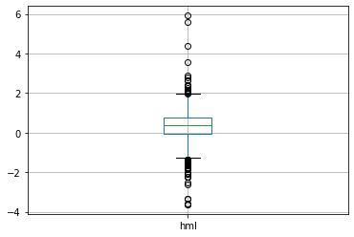
Risk Exposure Analysis
Fama French Three-Factor Model
Handling outliers
Run FF three factor model regression on 1923 unique companies
RET -rf = ɑ + β*mktrf + s*smb + h*hml + e
Output: 1923 obs, 7 columns - Ticker, R2, AdjR2, constant, mktrf, smb, hml
Missing values
AdjR2(4): N <= p−1 → undefined
Constant(3): only 1 observation
Outliers: Winsorization
Risk-exposure factors
Mktrf: exposure to the overall market
Smb: exposure to small cap stocks
Hml: exposure to value stocks
Final distribution
>1 >0 >0
Notes:
STEP (1) OF ANALYSIS (RISK EXPOSURES): Discuss data (sample size, how did you deal with missing observations? How did you deal with outliers?)
STEP (1) OF ANALYSIS (RISK EXPOSURES): Sample statistics, description of variables, include graphs to summarize data.
A factor beta (sometimes called a “factor loading”) is the sensitivity of security’s returns to a particular systematic factor.
With this model, market returns can roughly be explained by three factors: (1) exposure to the overall market (RMKT - Rf); (2) exposure to small cap stocks (SMB); and (3) exposure to value stocks (HML). • When small stocks do well relative to large stocks, this will be positive; when they do worse than large stocks, this will be negative
Positive coefficient - High book-to-market stocks are considered “value” stocks; negative coefficient - low book-to-market stocks are considered “growth” stocks.

Slide 5
Financial Ratio Analysis
Financial ratios
Financial report data
Sample Size
For the year of 2021 from 1886 companies
1886 observations and 23 columns
Missing Values
Linear Regression to predict missing values
Profitability ratio
ROA = Ebit/Total assets
ROE = net income/seq
Net profit margin = Ebit/Total sales
Gross profit margin = (net sales - cost of goods sold)/ net sales
Market value ratio
Book/Price = 1/[Price/Book] = CEQ/(PRCC_C * CSHO )
E/P = 1/[P/E] = NI/ (PRCC_C * CSHO )
EBIT/P = 1/[P/EBIT] = EBIT / (PRCC_C * CSHO )
SALE/P = 1/[P/SALES] = SALE / (PRCC_C * CSHO )
Liquidity Ratios
Quick ratio = (Current assets - Inventory)/Current liabilities
Current ratio= Current assets/Current liabilities
Leverage ratios
Debt to Equity = Total liability/Total shareholders equity(seq)
Cash ratio = (Cash +cash equivalents)) / Current liabilities
Asset management ratios
Asset turnover ratio = total sales/ total assets
Inventory turnover ratio = Cost of goods sold /Inventory
Data | Missing values | Adj R2 | Independent variables
Current assets | 455 | 0.84 | "at","sale","re","revt","che",'ni','cogs','csho'
Liabilities total | 5 | 0.954 | "at","sale","re","revt","che",'ni','cogs','csho'
Current liabilities | 455 | 0.813 | "lt","at","revt","sale","che",'csho','ceq','ebit'
Cash | 29 | 0.922 | "che","ni","ebit"
Inventory total | 34 | 0.609 | "at","lt",'act','lct',"che",'csho','seq','sale','ebit',"cogs",'mkvalt'
Notes:
STEP (2) OF ANALYSIS (RATIOS): Discuss data and your 10 variables. Why did you select the 10 variables? (Also discuss sample size, how did you deal with missing observations? How did you deal with outliers?)
STEP (2) OF ANALYSIS (RATIOS): Sample statistics, description of variables, include graphs to summarize data. Do each of the 10 ratios make sense?

Slide 6
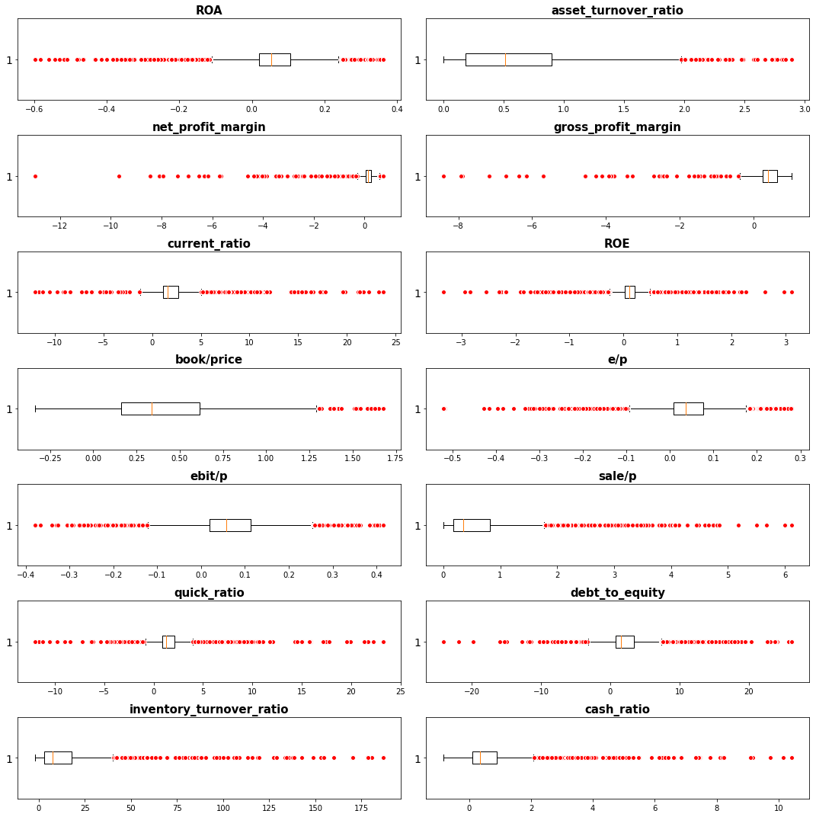
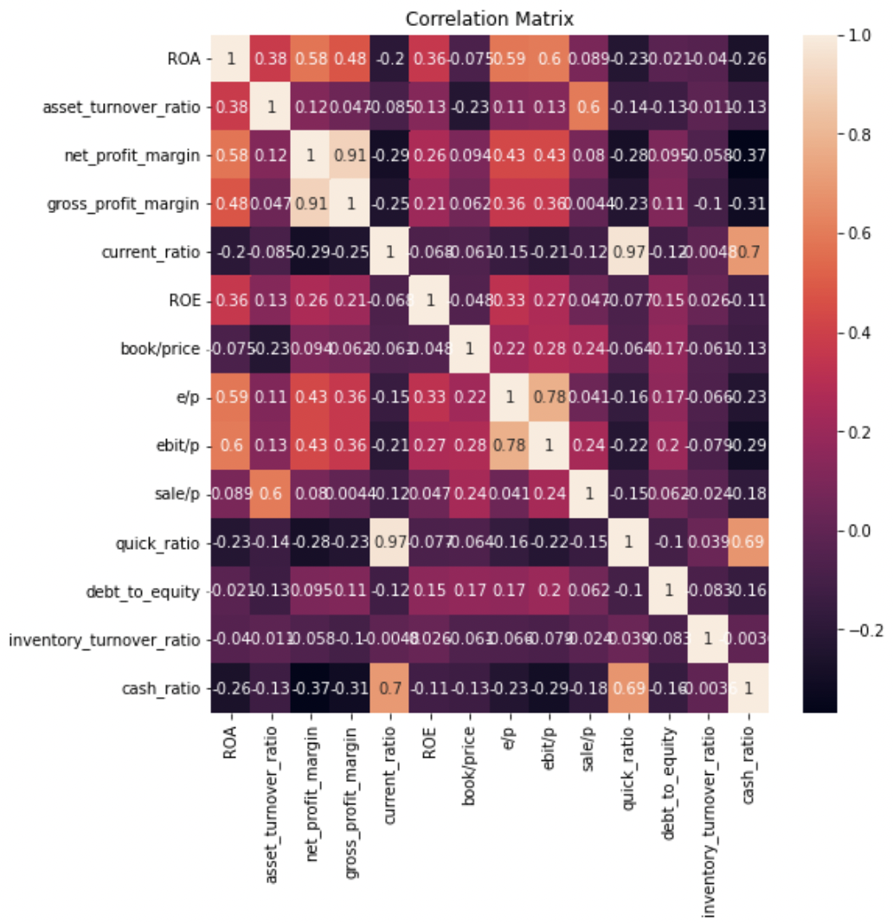
Financial Ratio Analysis - Closer look
Sample statistics
14 ratios, 1886 observations
Inventory turnover ratio: 27% infinite values
Net profit margin: 17 missing values
Gross profit margin: 17 missing values
Missing & Infinite values
Both numerator & denominator 0
Sale, invt, cogs == 0
Mostly gsector 35 Health Care & ggroup 3520 Pharmaceuticals, Biotechnology companies
Replace with mean
Outliers - winsorization
Final distribution
Box plot
Correlation matrix
 | Inventory turnover ratio | Net profit margin | Gross profit margin
mean | Nan | -inf | -0.3
std | Nan | Nan | 13.8
min | -inf | inf | -498.1
max | inf | 1.2 | 1.2
Notes:
STEP (2) OF ANALYSIS (RATIOS): Discuss data and your 10 variables. Why did you select the 10 variables? (Also discuss sample size, how did you deal with missing observations? How did you deal with outliers?)
STEP (2) OF ANALYSIS (RATIOS): Sample statistics, description of variables, include graphs to summarize data. Do each of the 10 ratios make sense?

Slide 7
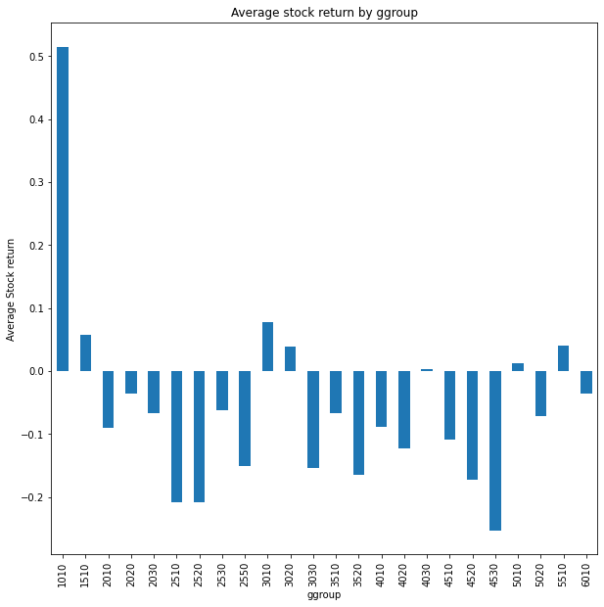
Industry indicator analysis
Industry indicator data
Sample Size
industry identifier data for the year 2021 with 1886 Tickers
1886 observations and 15 columns
Gsector, ggroup, gind, gsubind
No missing values
Merge with stock return data
Generate dummy variables using ggroup
Average stock return by industry
ggroup 1010 (energy) - the highest stock return
ggroup 4530 (Semiconductors & Semiconductor Equipment) - the lowest stock return during early 2022.
Notes:
STEP (3) OF ANALYSIS (INDUSTRIES): Discuss data (sample size, how did you deal with missing observations? What are the industries?)
STEP (3) OF ANALYSIS (INDUSTRIES): Sample statistics (# stocks in each industry), include graphs to summarize data.

Slide 8
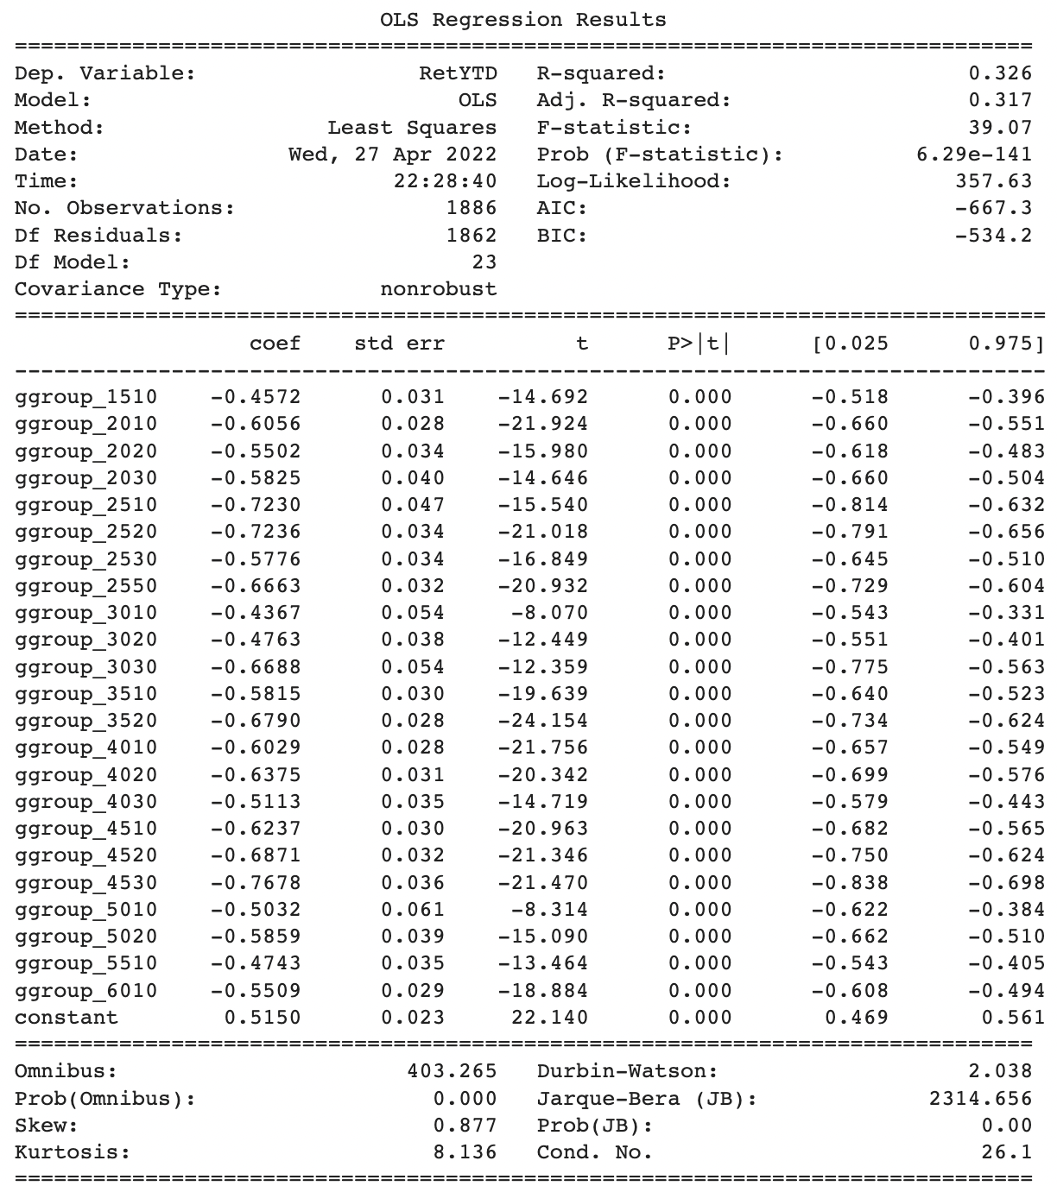
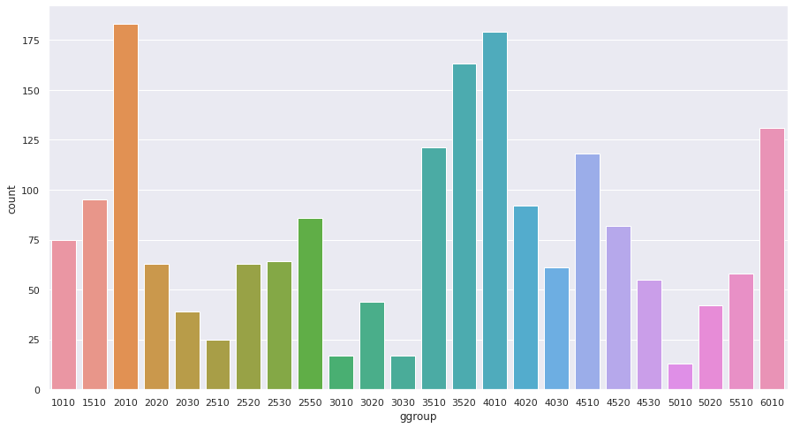
Industry indicator analysis
Sample Statistics
24 unique industry groups
1886 observations
No missing values
Commercial & Professional Services(ggroup 2010): highest obs
Telecommunication Services(ggroup 5010): lowest obs
Regression: drop first industry(1010)
Constant: average stock return of 1010
Notes:
STEP (3) OF ANALYSIS (INDUSTRIES): Discuss data (sample size, how did you deal with missing observations? What are the industries?)
STEP (3) OF ANALYSIS (INDUSTRIES): Sample statistics (# stocks in each industry), include graphs to summarize data.

Slide 9
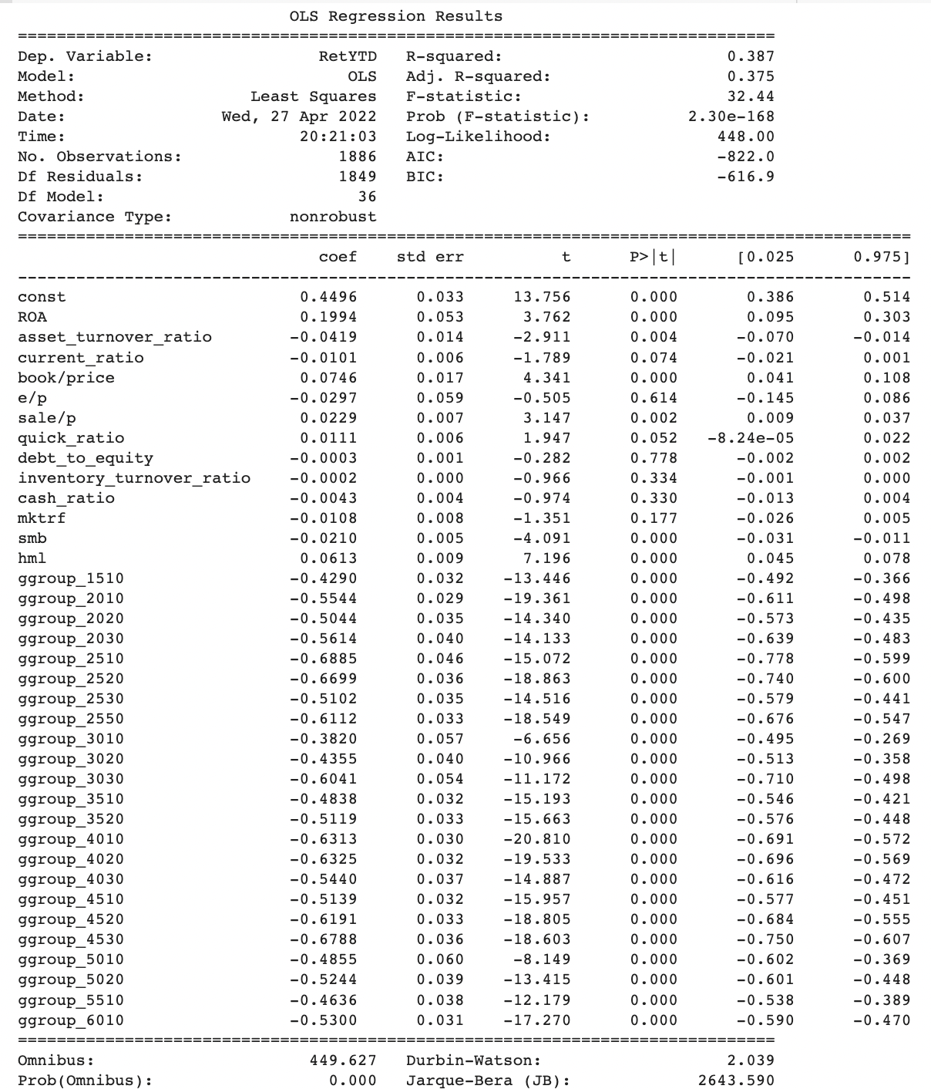
Combined Regression model
Final combined regression results
Regression Summary
1886 observation
Explanatory power: 0.387
Coefficients:
Significance (<0.05)
Positive or negative direction
ROA(+), asset turnover ratio(-), book/price(+), sales/price(+).
smb(+), hml(+)
Industry indicators
Model comparison table
Regression | Adj R2 | Independent variables
Risk regression | 0.092 | Mktrf, smb, hml (coefficients output)
Financial regression | 0.098 | Financial ratios
Industry regression | 0.326 | Industry indicators
Combined regression | 0.387 | All together
Notes:
Presentation of regressions and interpretation and explanation of results.
Sensitivity of a portfolio’s returns to changes in a systematic factor also affected early 2022 stock return. Estimates of size factor(exposure to small stocks) affected negatively, while estimates of value factor(exposure to value stocks) affected positively on stock return.
Like mentioned in industry regression section, industry with the highest stock return was energy sector(ggroup 1010). Therefore, coefficients of all other industry indicators are negative, showing results relative to ggroup 1010.

Slide 10
Conclusion
Summary
The best model is combined regression: Adjusted R-squared 0.375
Regression with industry indicators performed second best
Financial characteristics regression and risk regression performed less than 0.1 R-squared
Industry indicator factors play significant role.
Limitation & Recommendations
Gather more data to increase explanatory factor
Deeper analysis on industry group
Dealing with missing values
Try another prediction model for inventory
Fill missing values with mean by industry; most of the missing values came from specific industry such as pharmaceutical companies.
Explainability
Unstable, dynamic, and adaptive stock market
Difficult to find pattern
Understand the characteristics of stock market and domain-based industry knowledge.
Notes:
STEP (3) OF ANALYSIS (INDUSTRIES): Discuss data (sample size, how did you deal with missing observations? What are the industries?)
STEP (3) OF ANALYSIS (INDUSTRIES): Sample statistics (# stocks in each industry), include graphs to summarize data.

